Slide 1
CCBR1044
Single-cell RNA-seq analysis of Intratumoral Heterogeneity of SCLC subgroups

Slide 2
Objectives
Analysis of
1 Intratumoral Heterogeneity of SCLC subgroups
2 Analysis of potential groups of interest (groups that have changed based on therapy
3 Analysis of general state of immune infiltrate in patient samples

Slide 3
Methods/Samples
1.) Collecting samples from patients after Rapid Autopsy, with dissociation and capture as soon as physically possible after patients pass – 4 samples currently sequenced, more coming
2.) 9 reference cell lines spread across the 4 NAPY subgroups of SCLC
NAPY subgroups refer to dominance of the transcription factors Neurod1, ASCL1, Pou2F3 and YAP1 – all cell lines captured, not sequenced yet

Slide 4
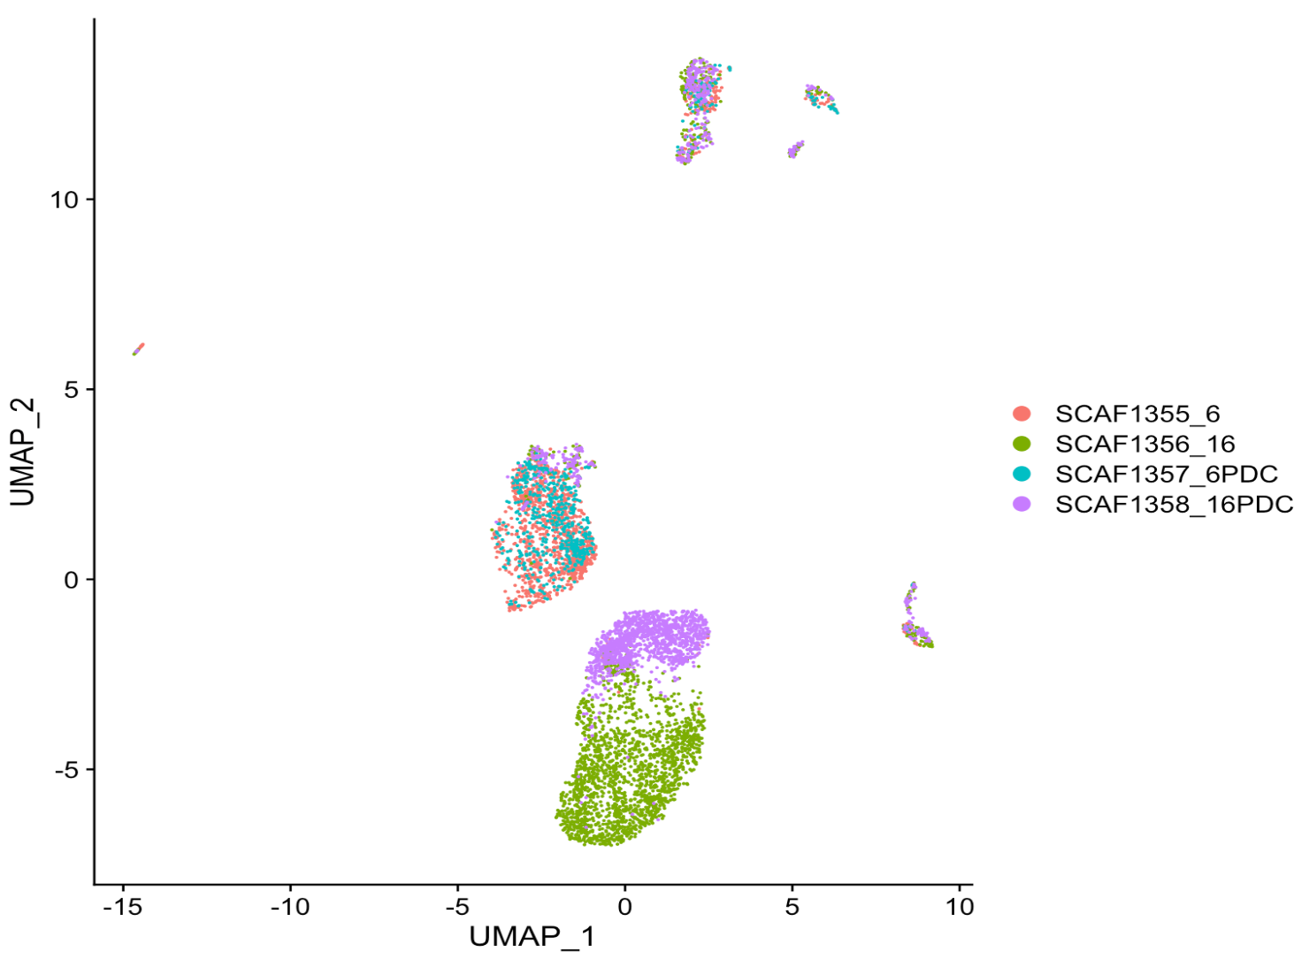
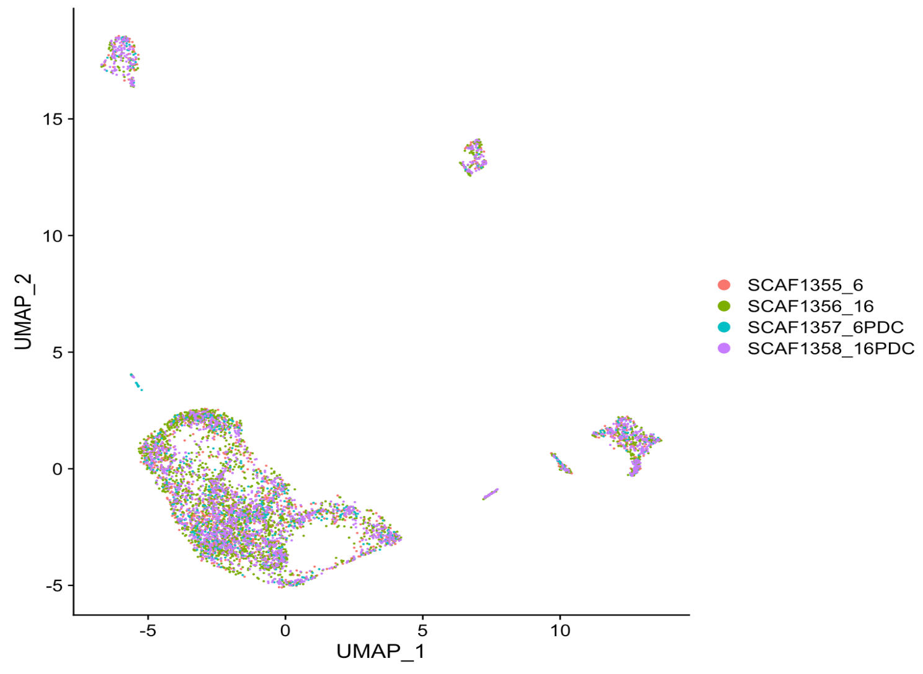
Color by sample, before and after batch correction
SCAF1355_6 and SCAF1357_6PDC are lymph-node met
SCAF1356_16 and SCAF1358_16PDC are liver met
Notes:
Slide1: before and after batch correction. You mentioned samples with _6 and _16 are lymph-node met and liver met respectively? At this point I cannot rule out the possibility that the main clusters actually separate.

Slide 5
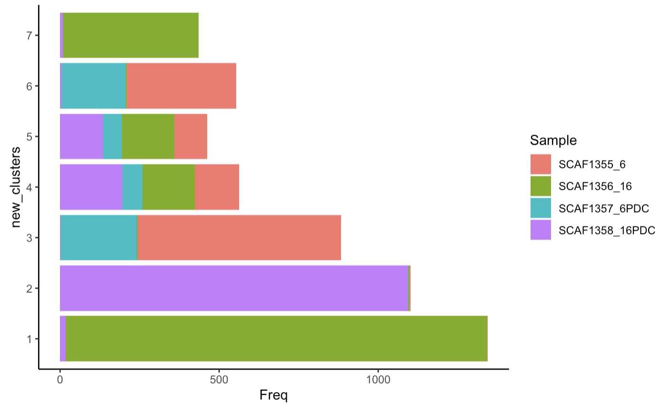
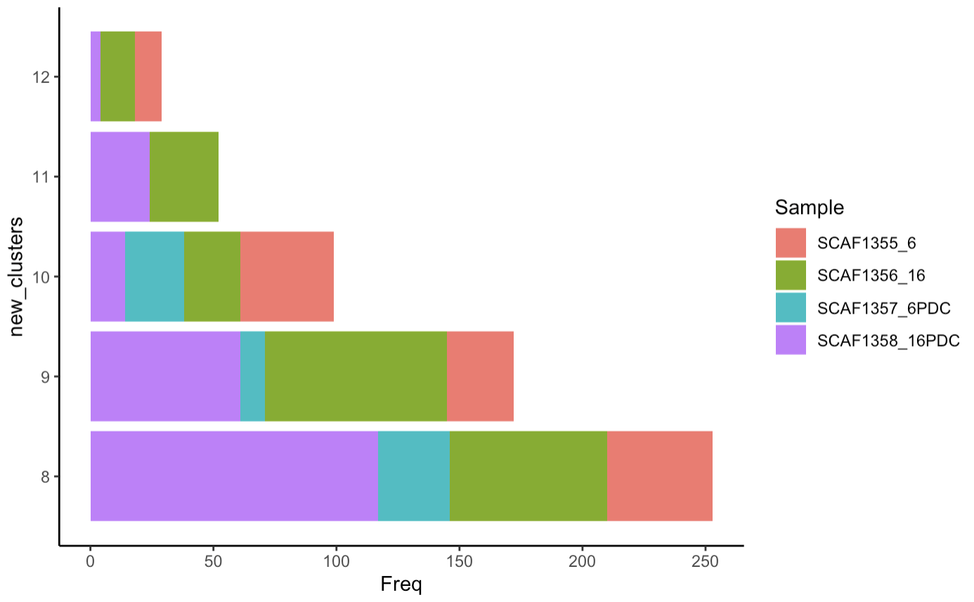
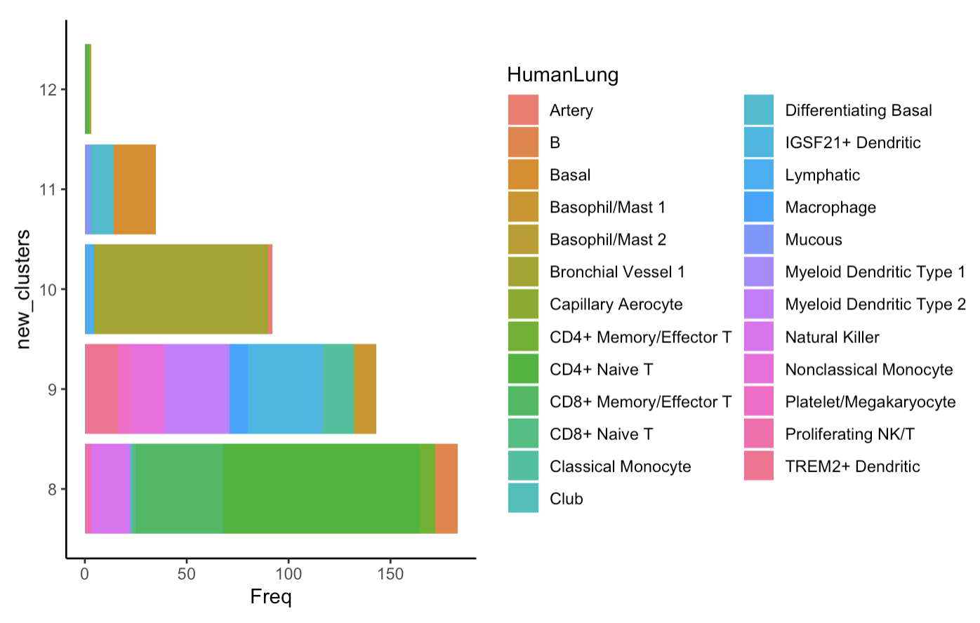
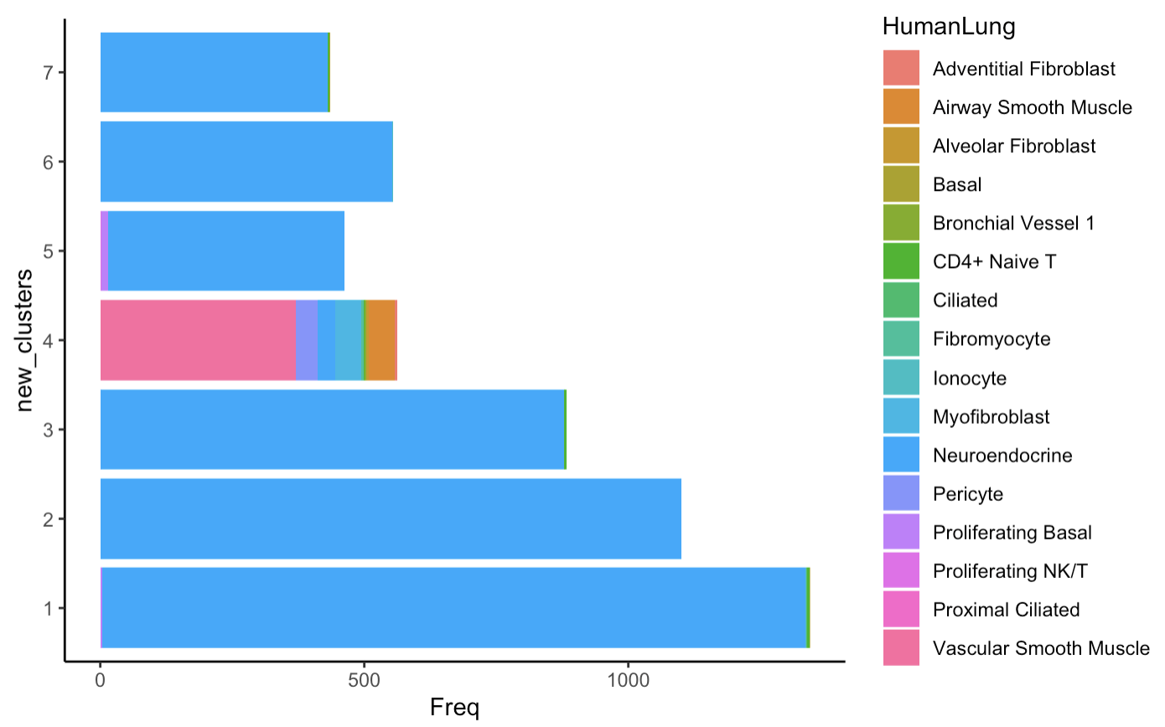
absolute number of cells by sample/identity

Slide 6
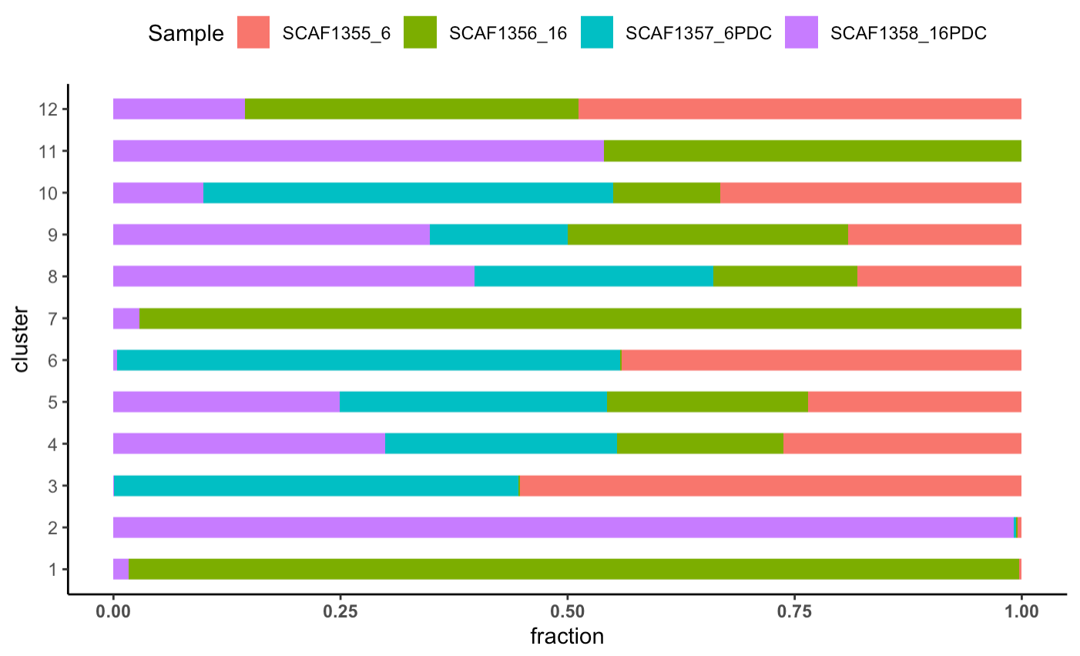
Well mixture of small anchor populations (e.g cluster4, connective tissues) in the pre-batch corrected tSNE plot indicates good integration. In addition, seperation of "SCAF1355_6", "SCAF1357_6PDC" samples from the other two samples (SCAF1356_16 and SCAF1358_16PDC) is also expected since they are metastatic tumor cells taken from lymph node and liver respectively. Taken together, the subsequent analysis is carried out using 0.6 resolution and merged object (without batch-correction).

Slide 7
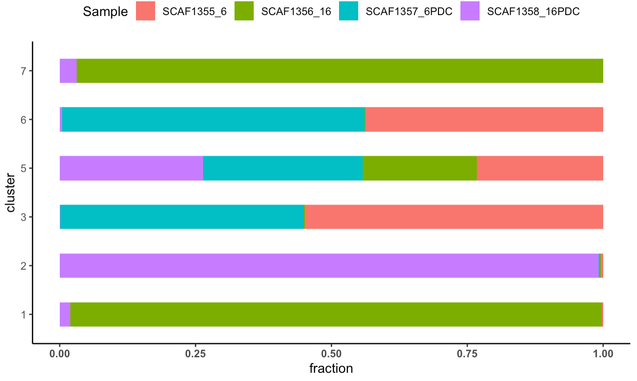
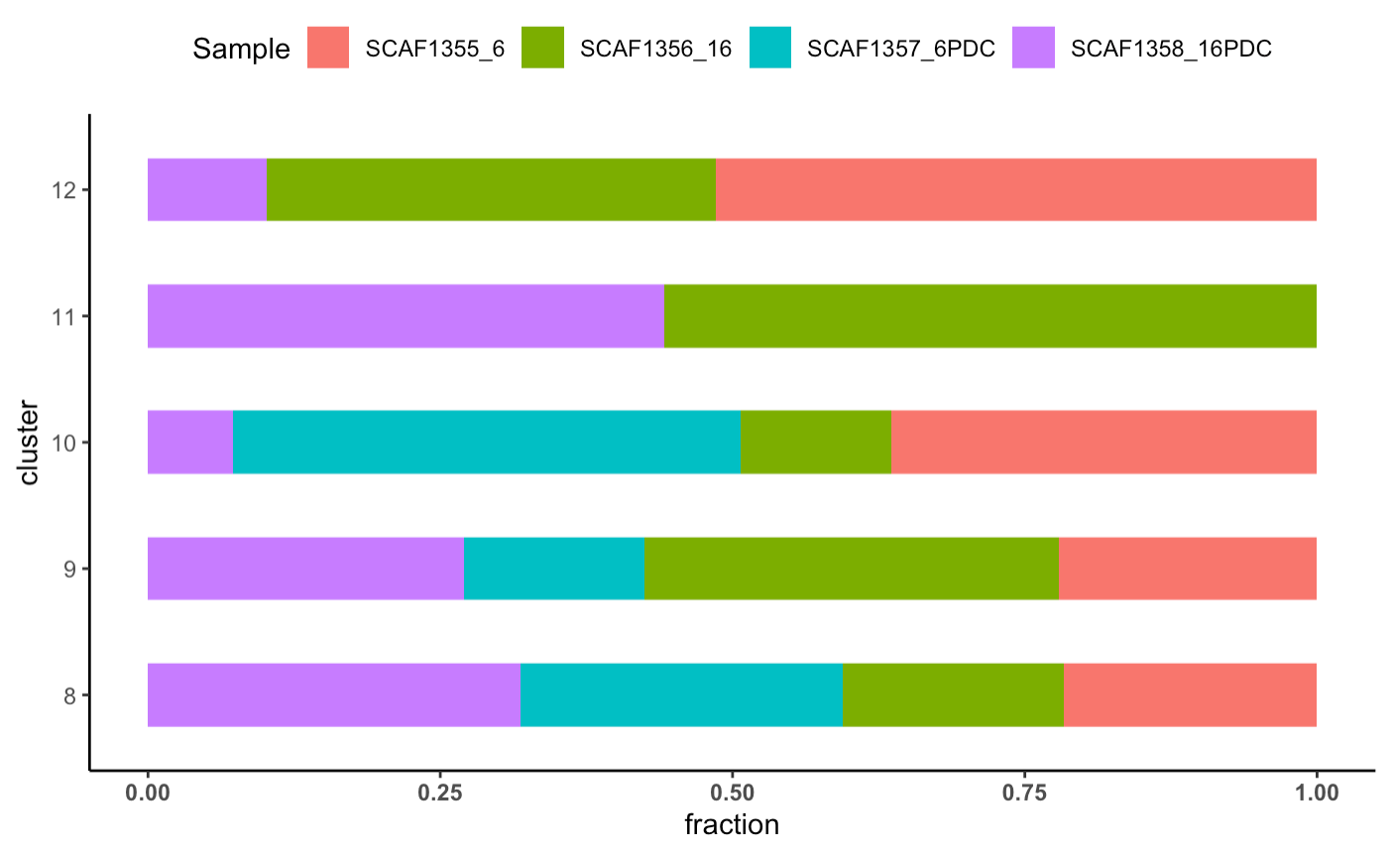
Relative fraction of cells by sample/identity after normalizing for total cell numbers
interesting
interesting
interesting

Slide 8
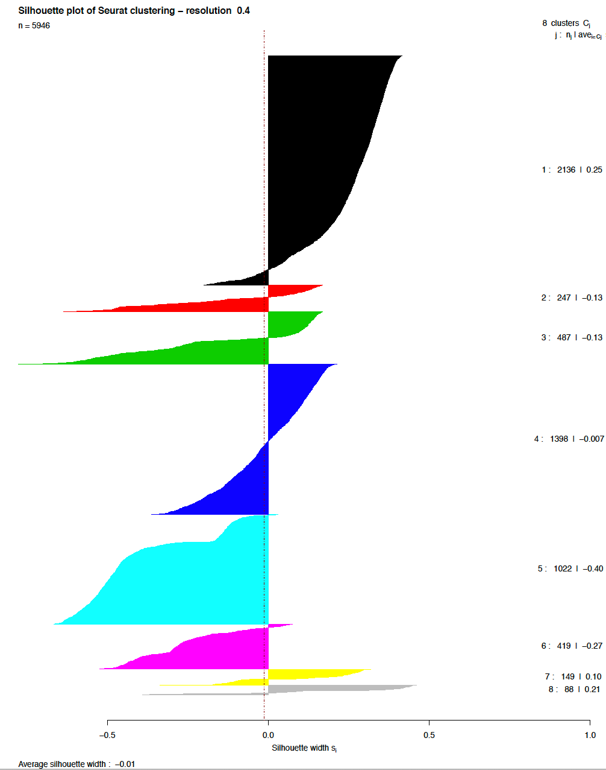
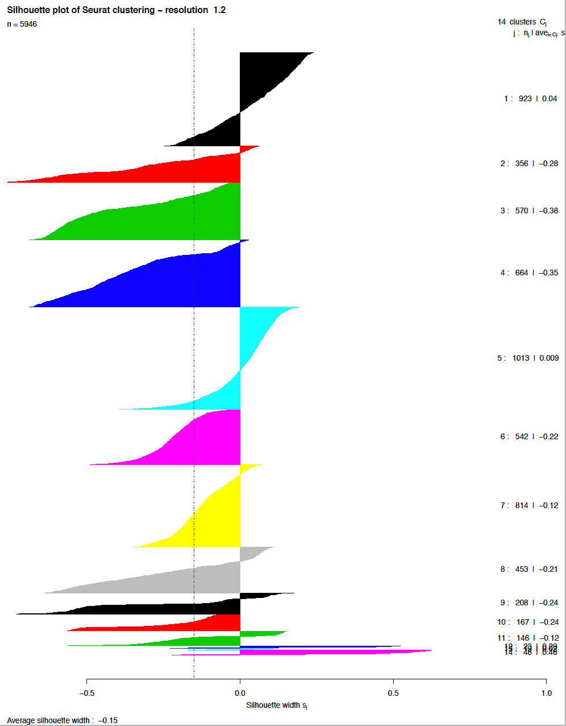
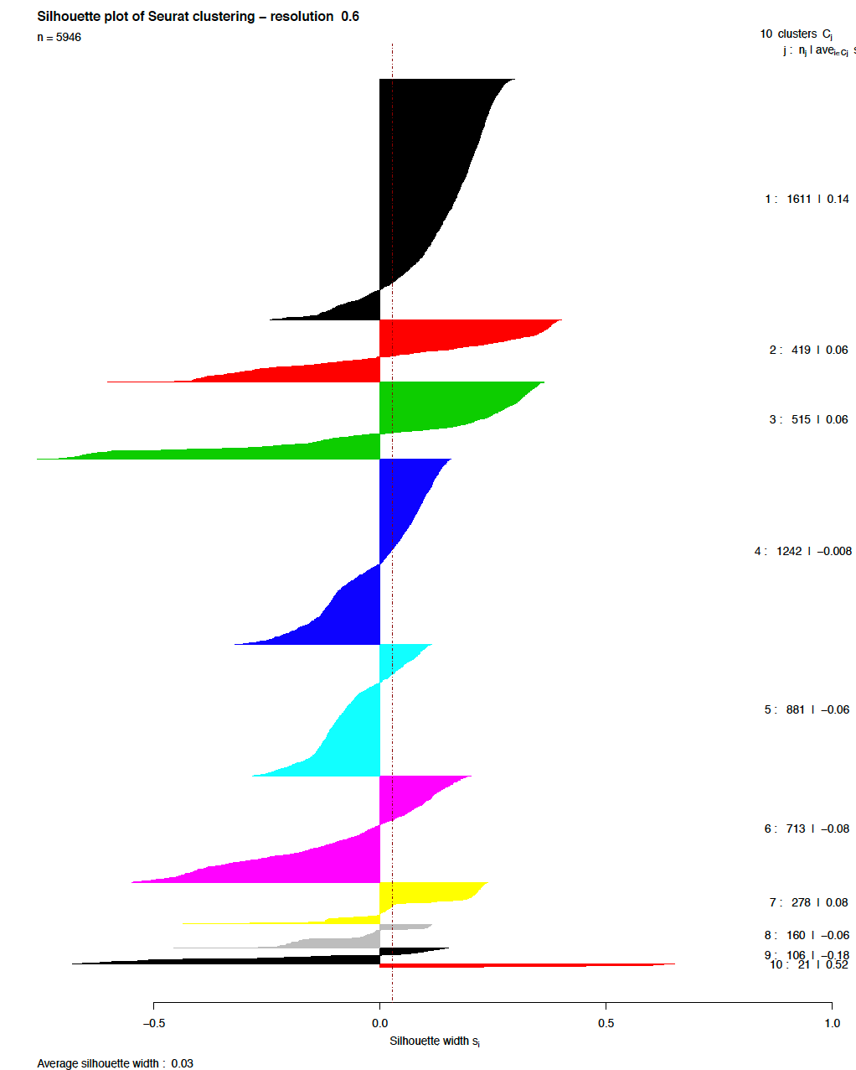
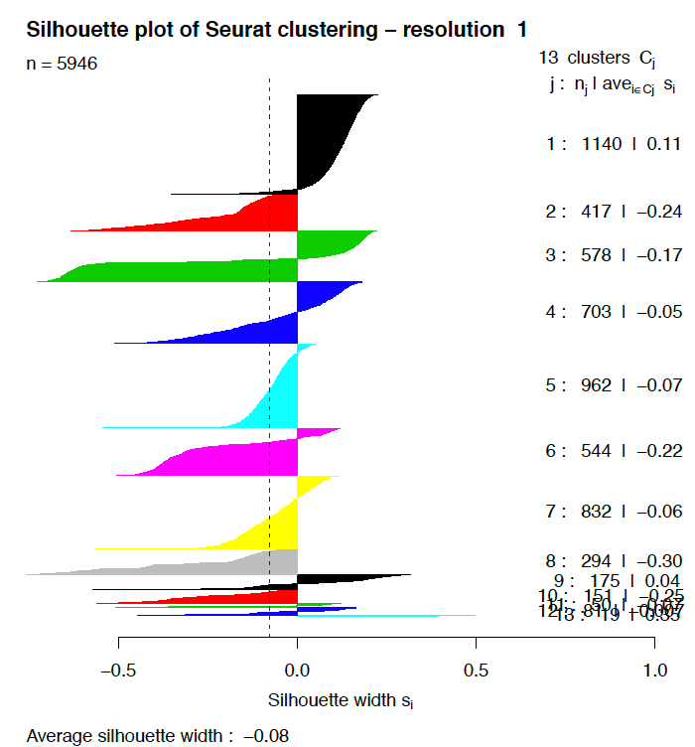
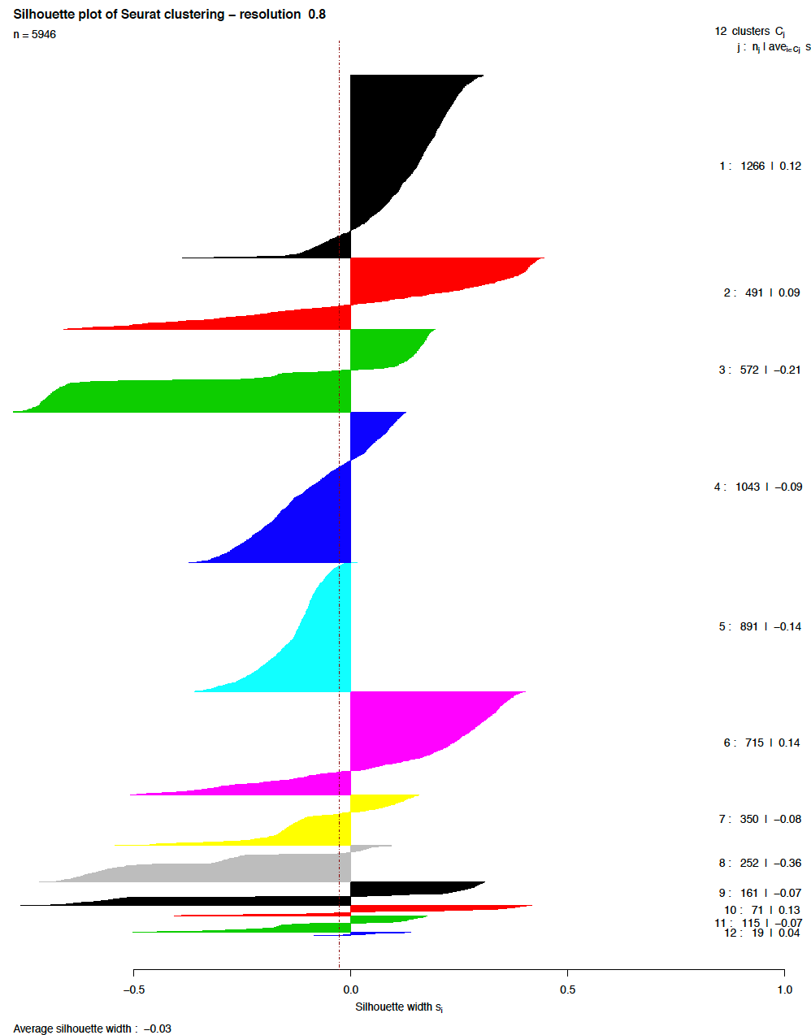

Slide 9
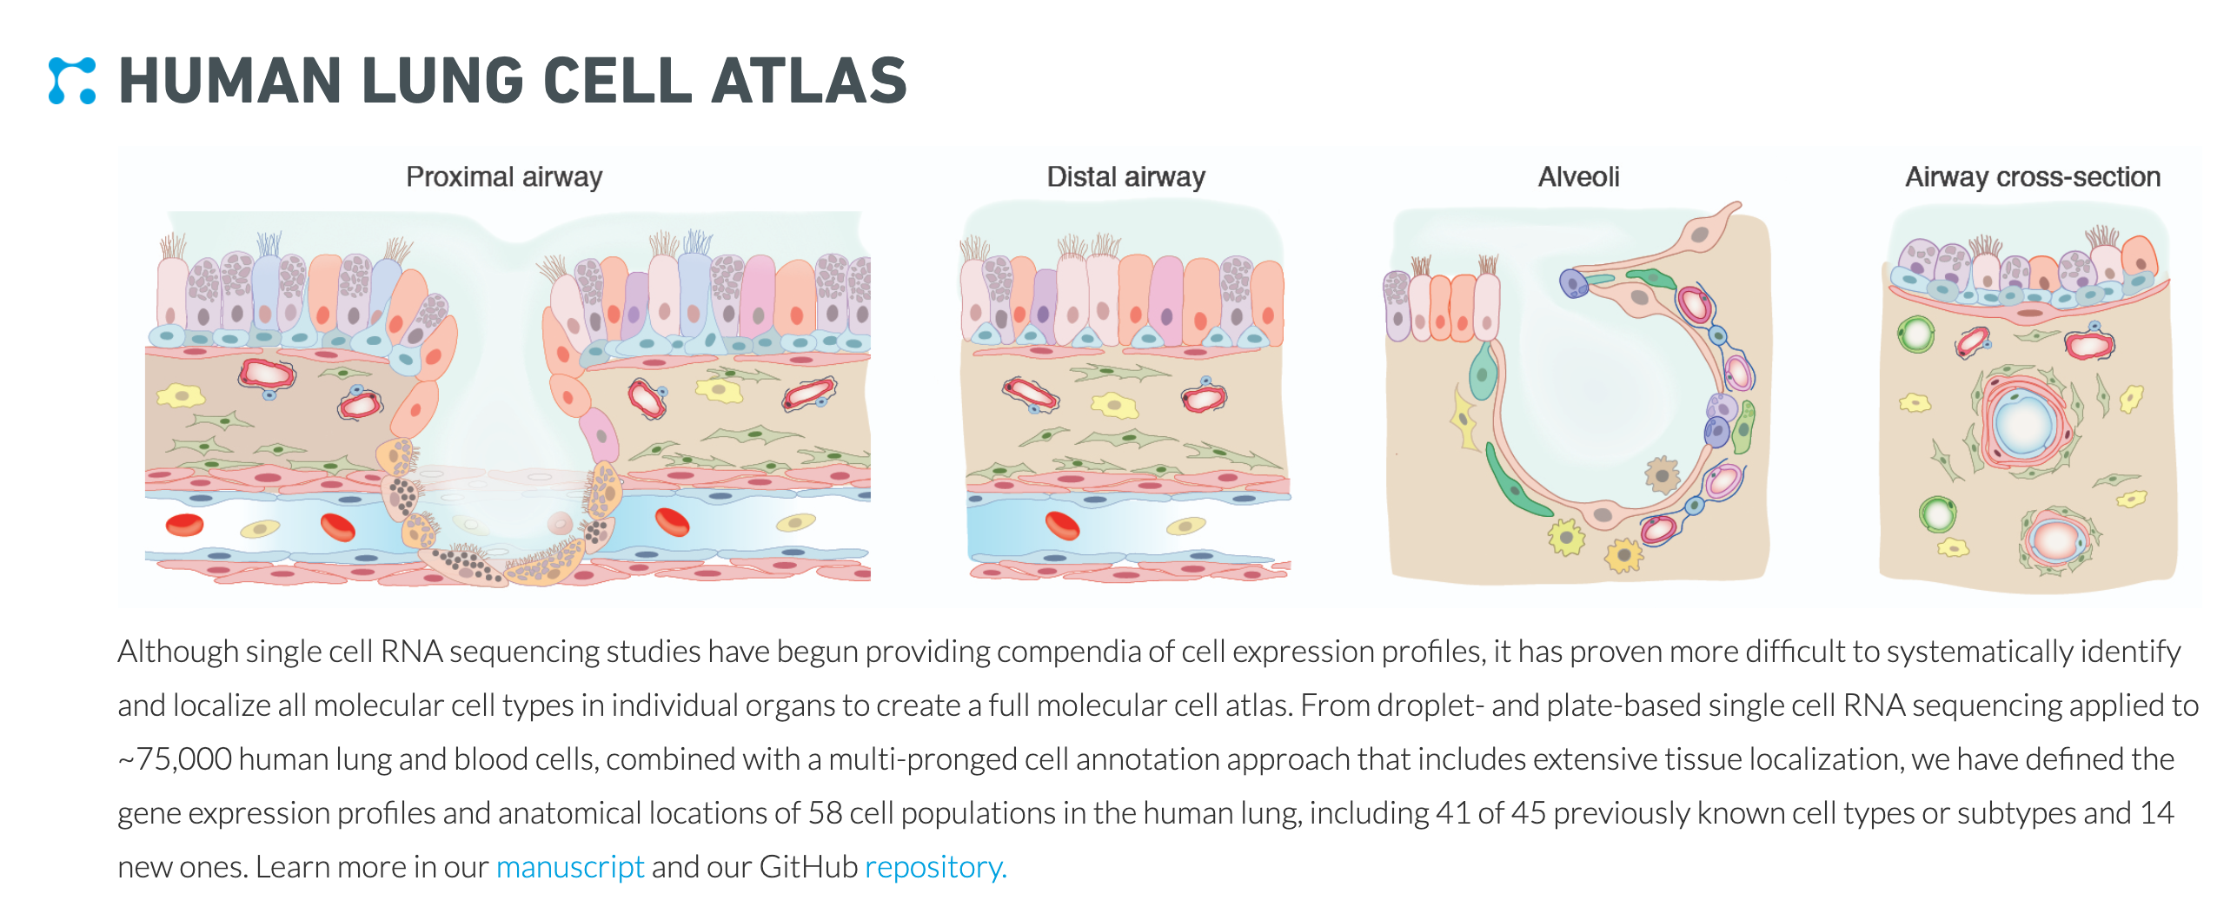
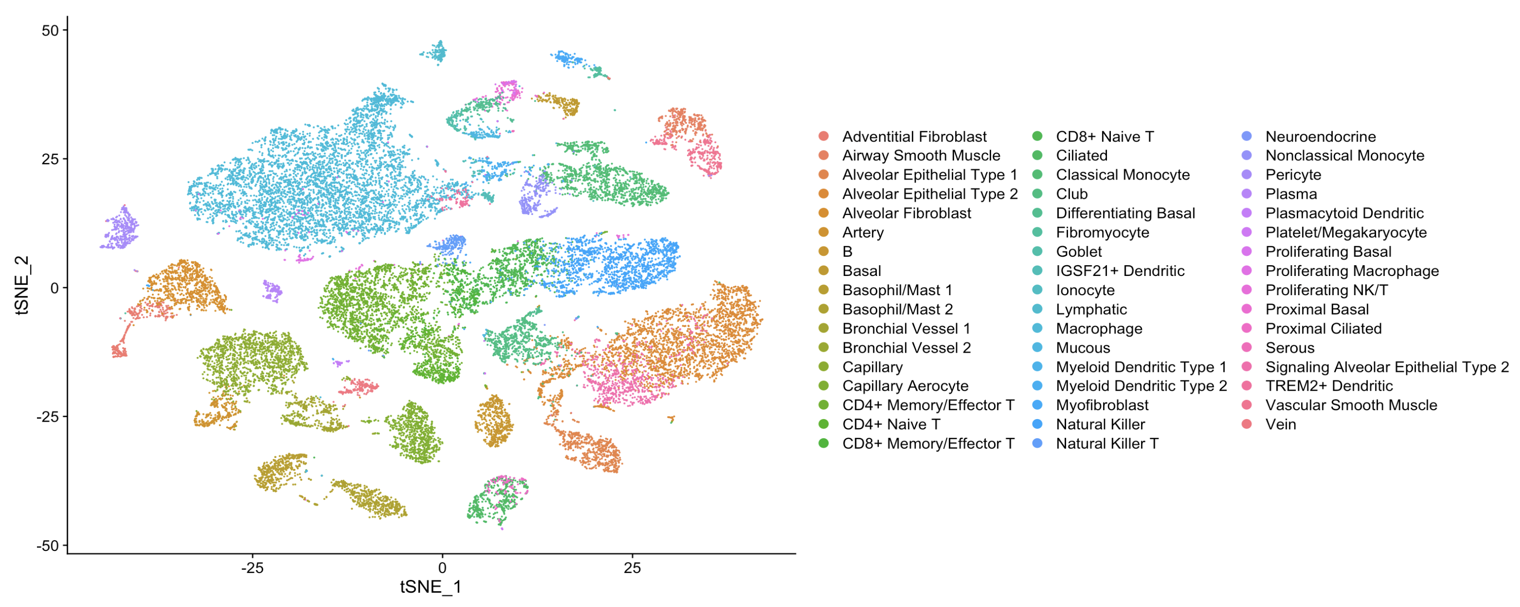
Neuroendocrine cells: 11/27125 = 0.04%

Slide 10
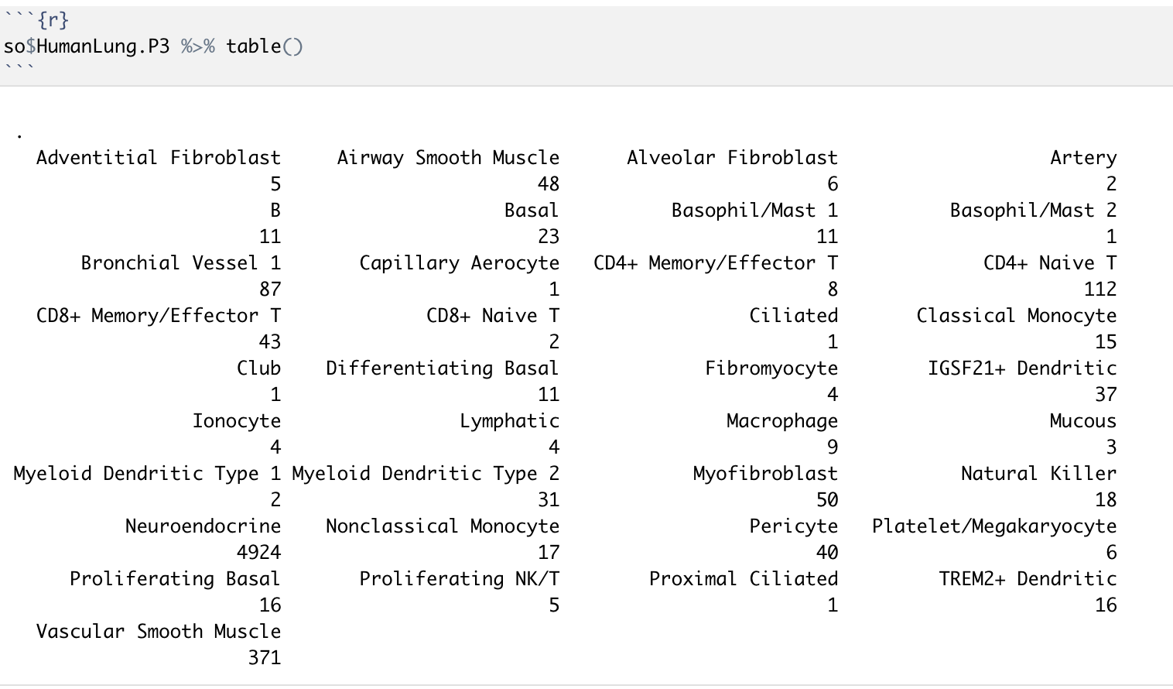
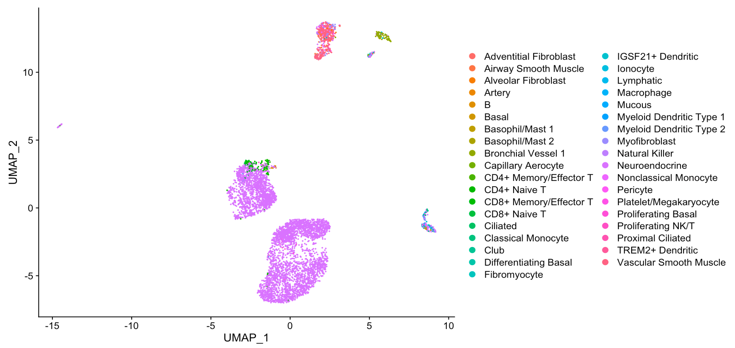
Small cell lung cancers are also classed as neuroendocrine tumours. Neuroendocrine tumours (NETs) are rare tumours that develop in cells of the neuroendocrine system. In small cell lung cancer, the tumour starts in the neuroendocrine cells of the lung.

Slide 11
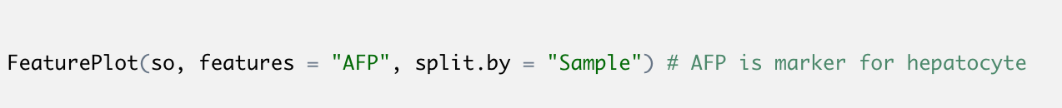
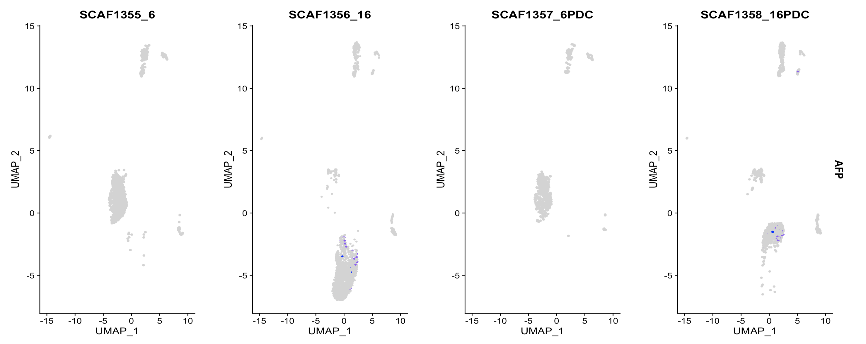
Hepatocytes?

Slide 12
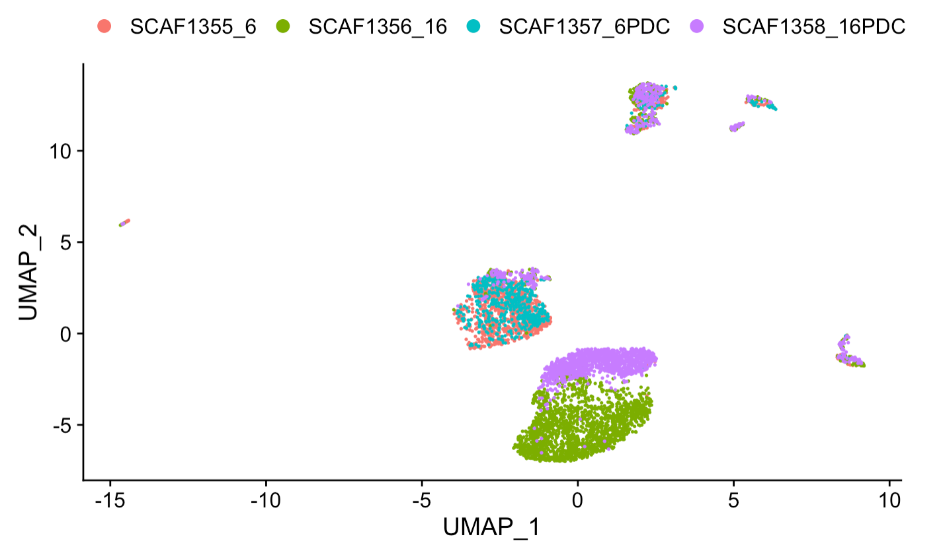
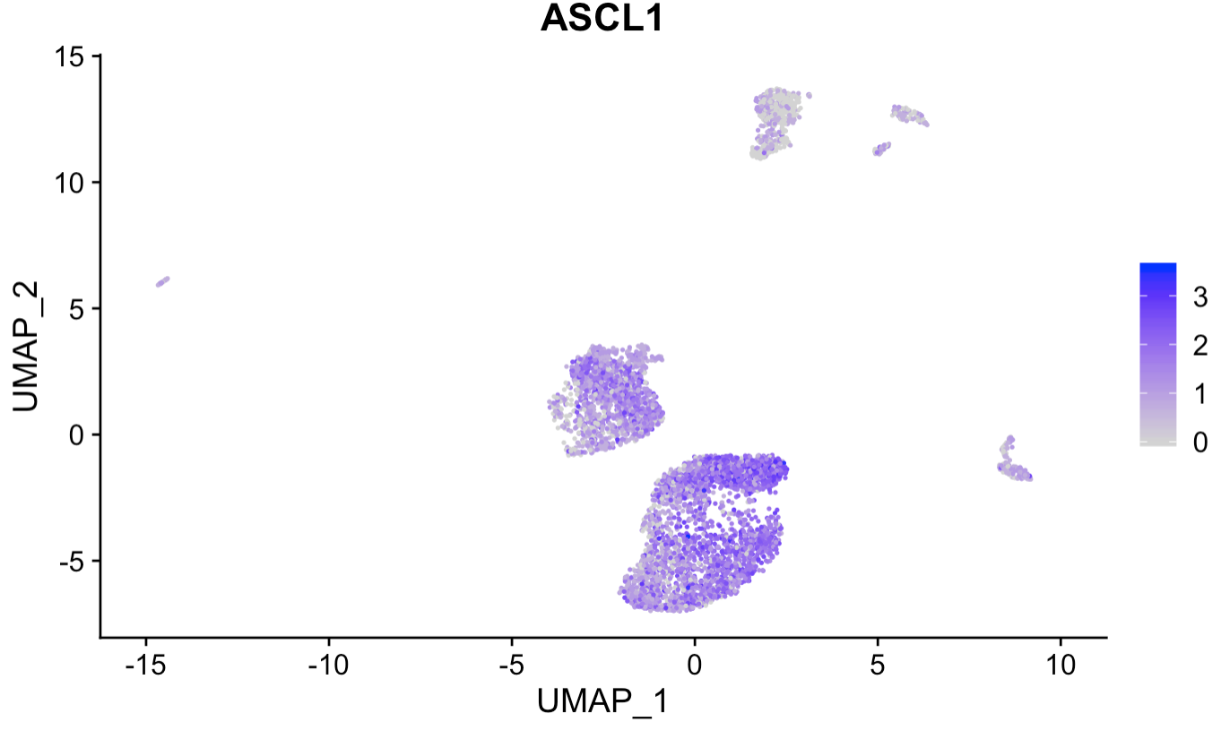
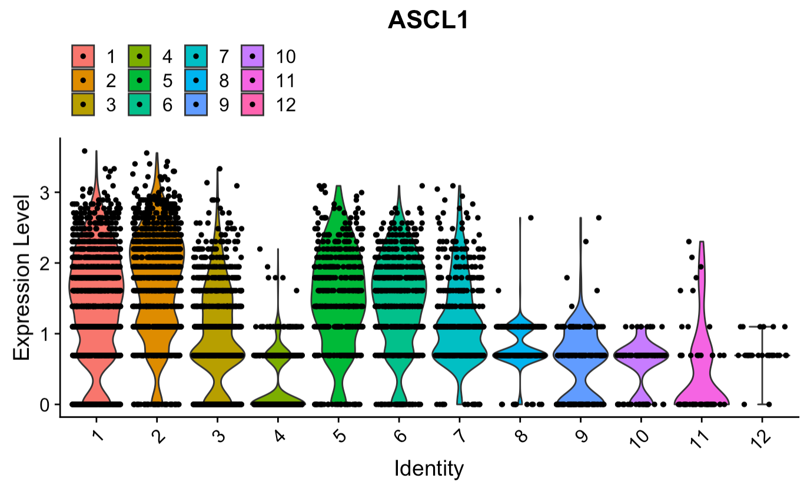
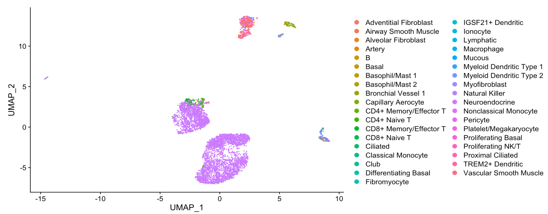
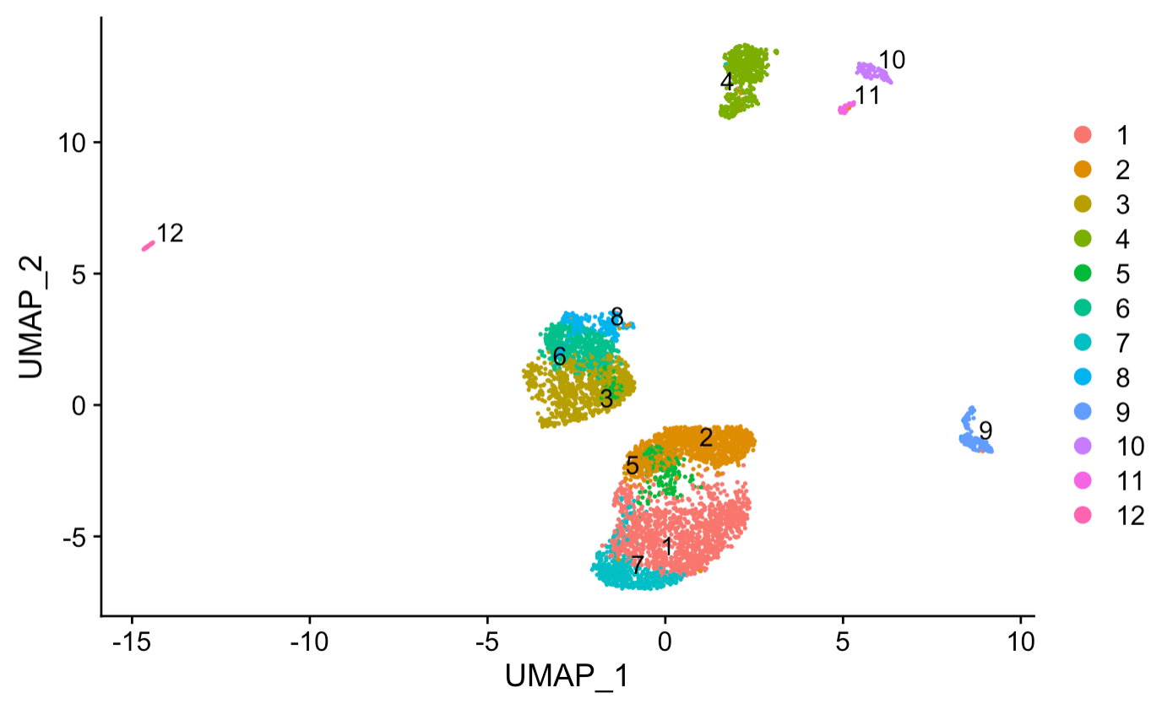
ASCL1 expression

Slide 13
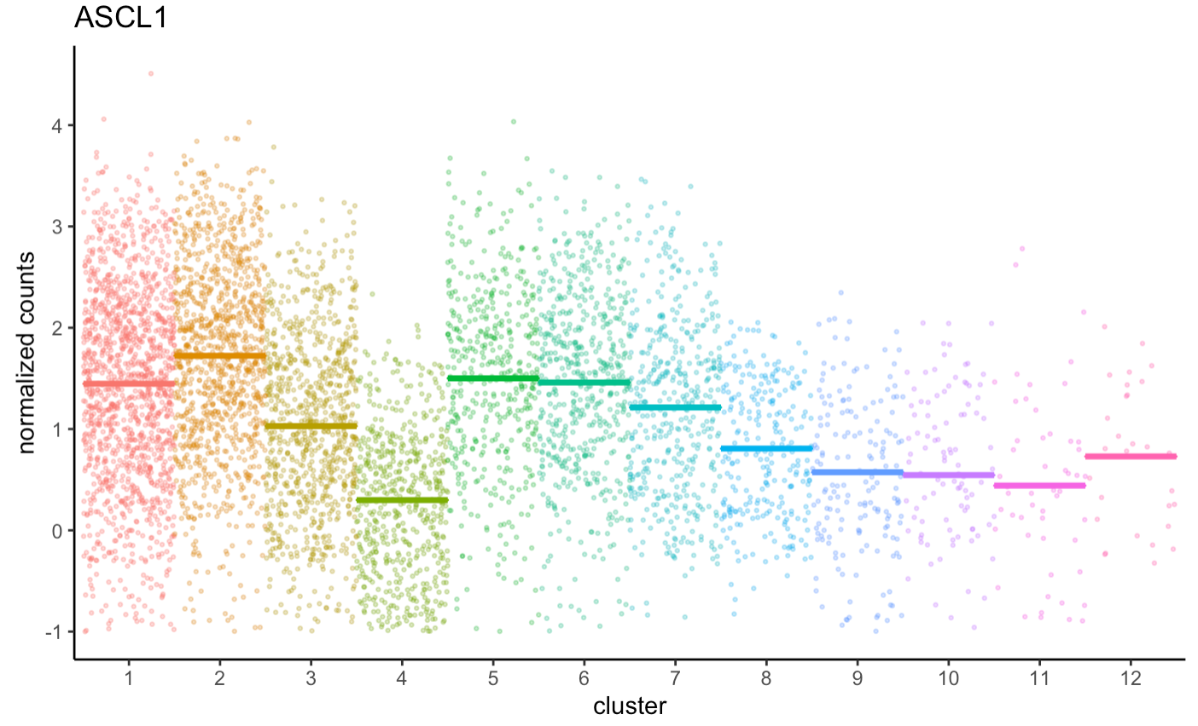
ASCL1 expression

Slide 14
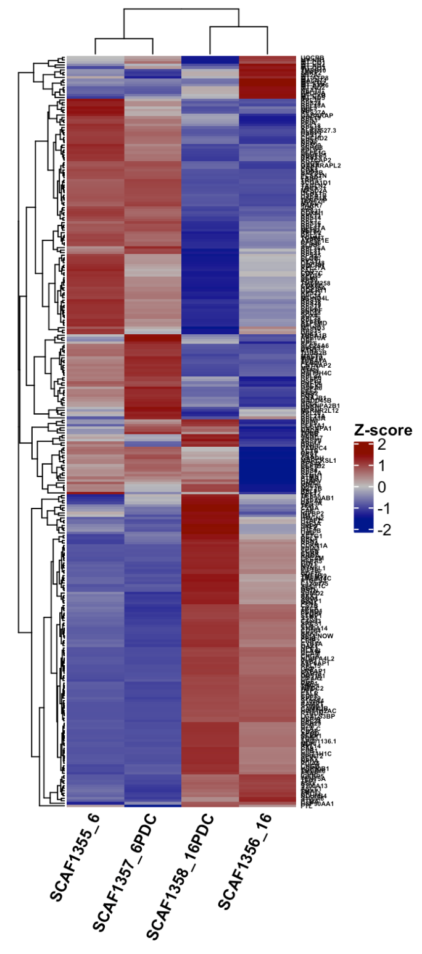
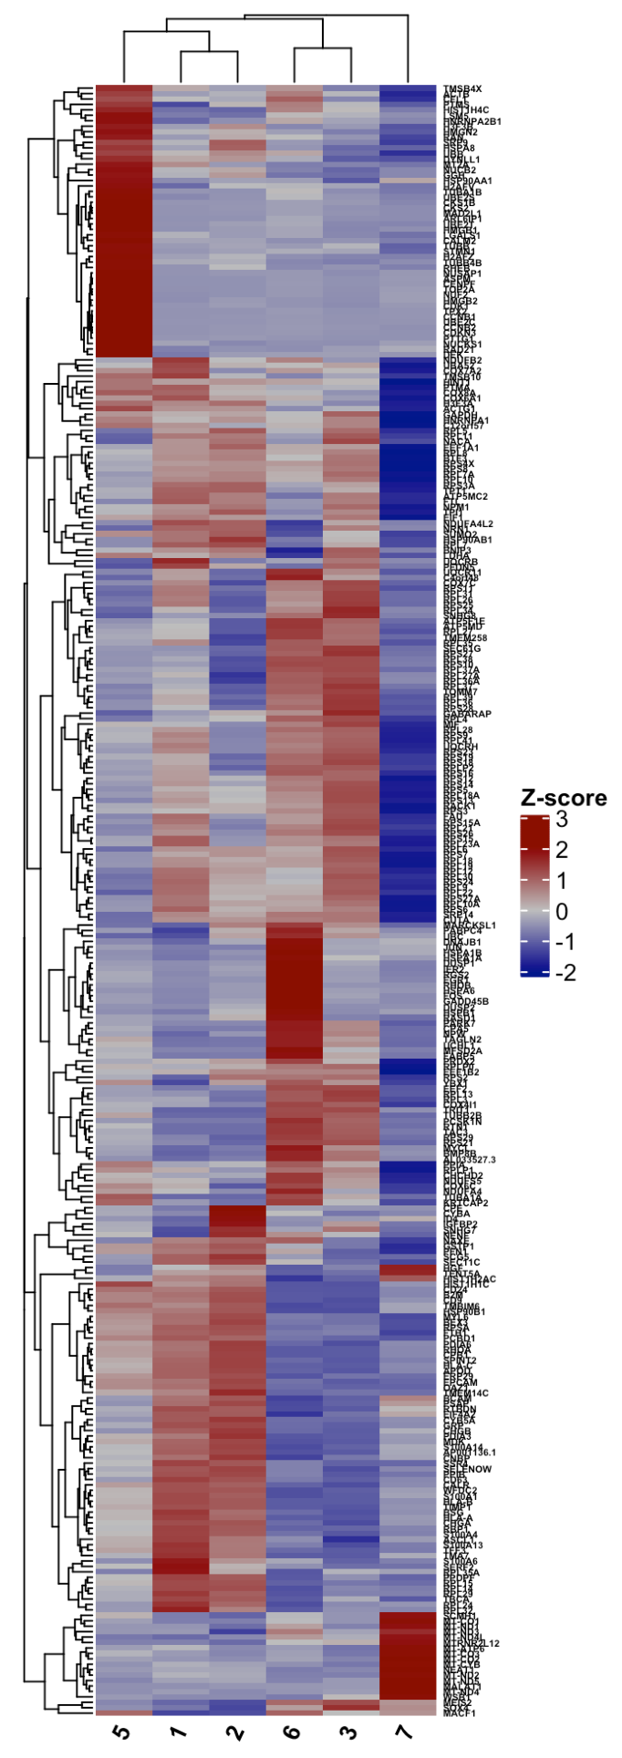
Clustering based on the SCLCs

Slide 15
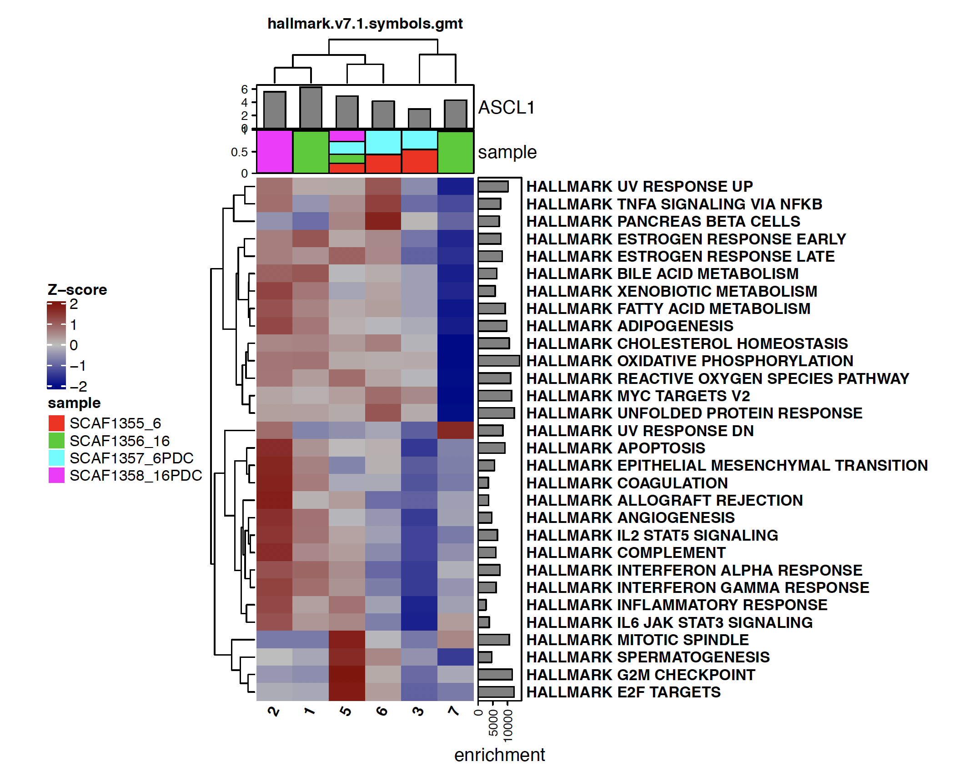
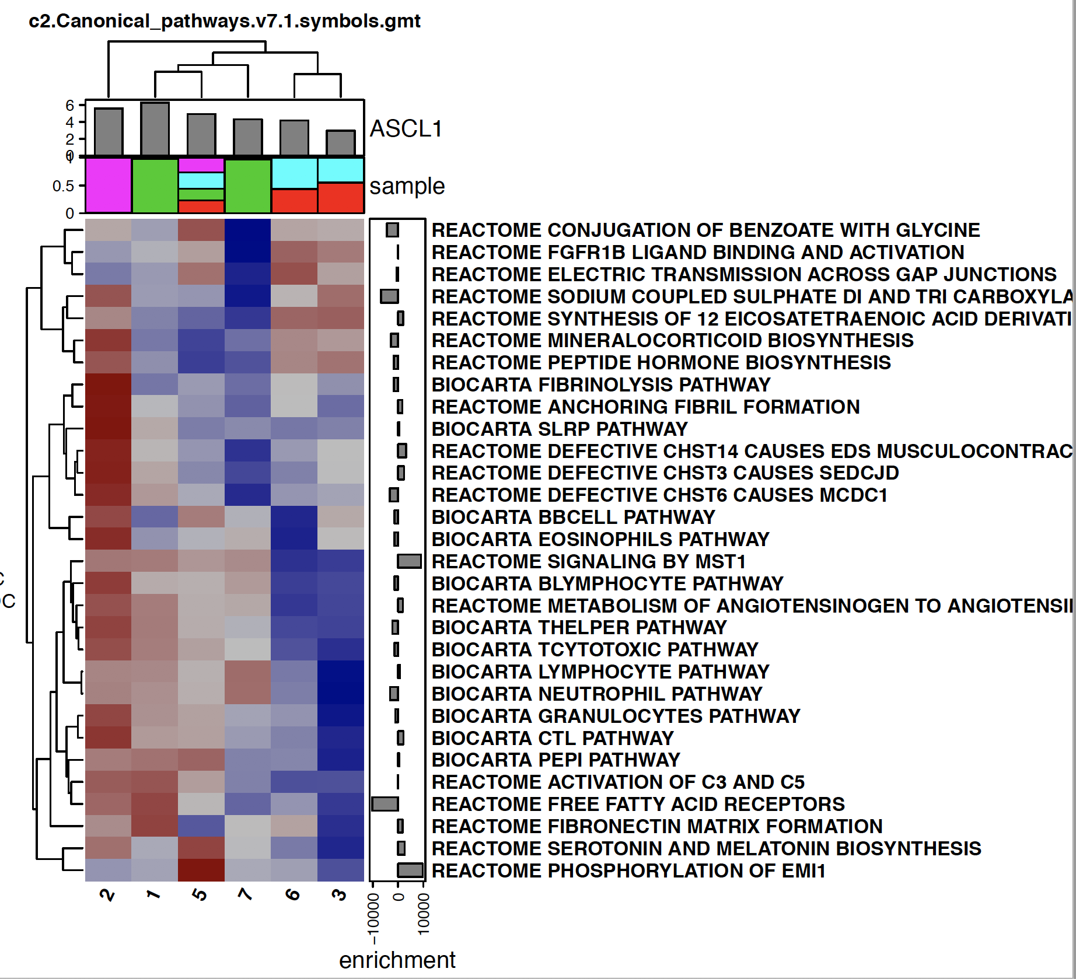
SCLC clusters hallmark and canonical pathway GSCA enrichment

Slide 16
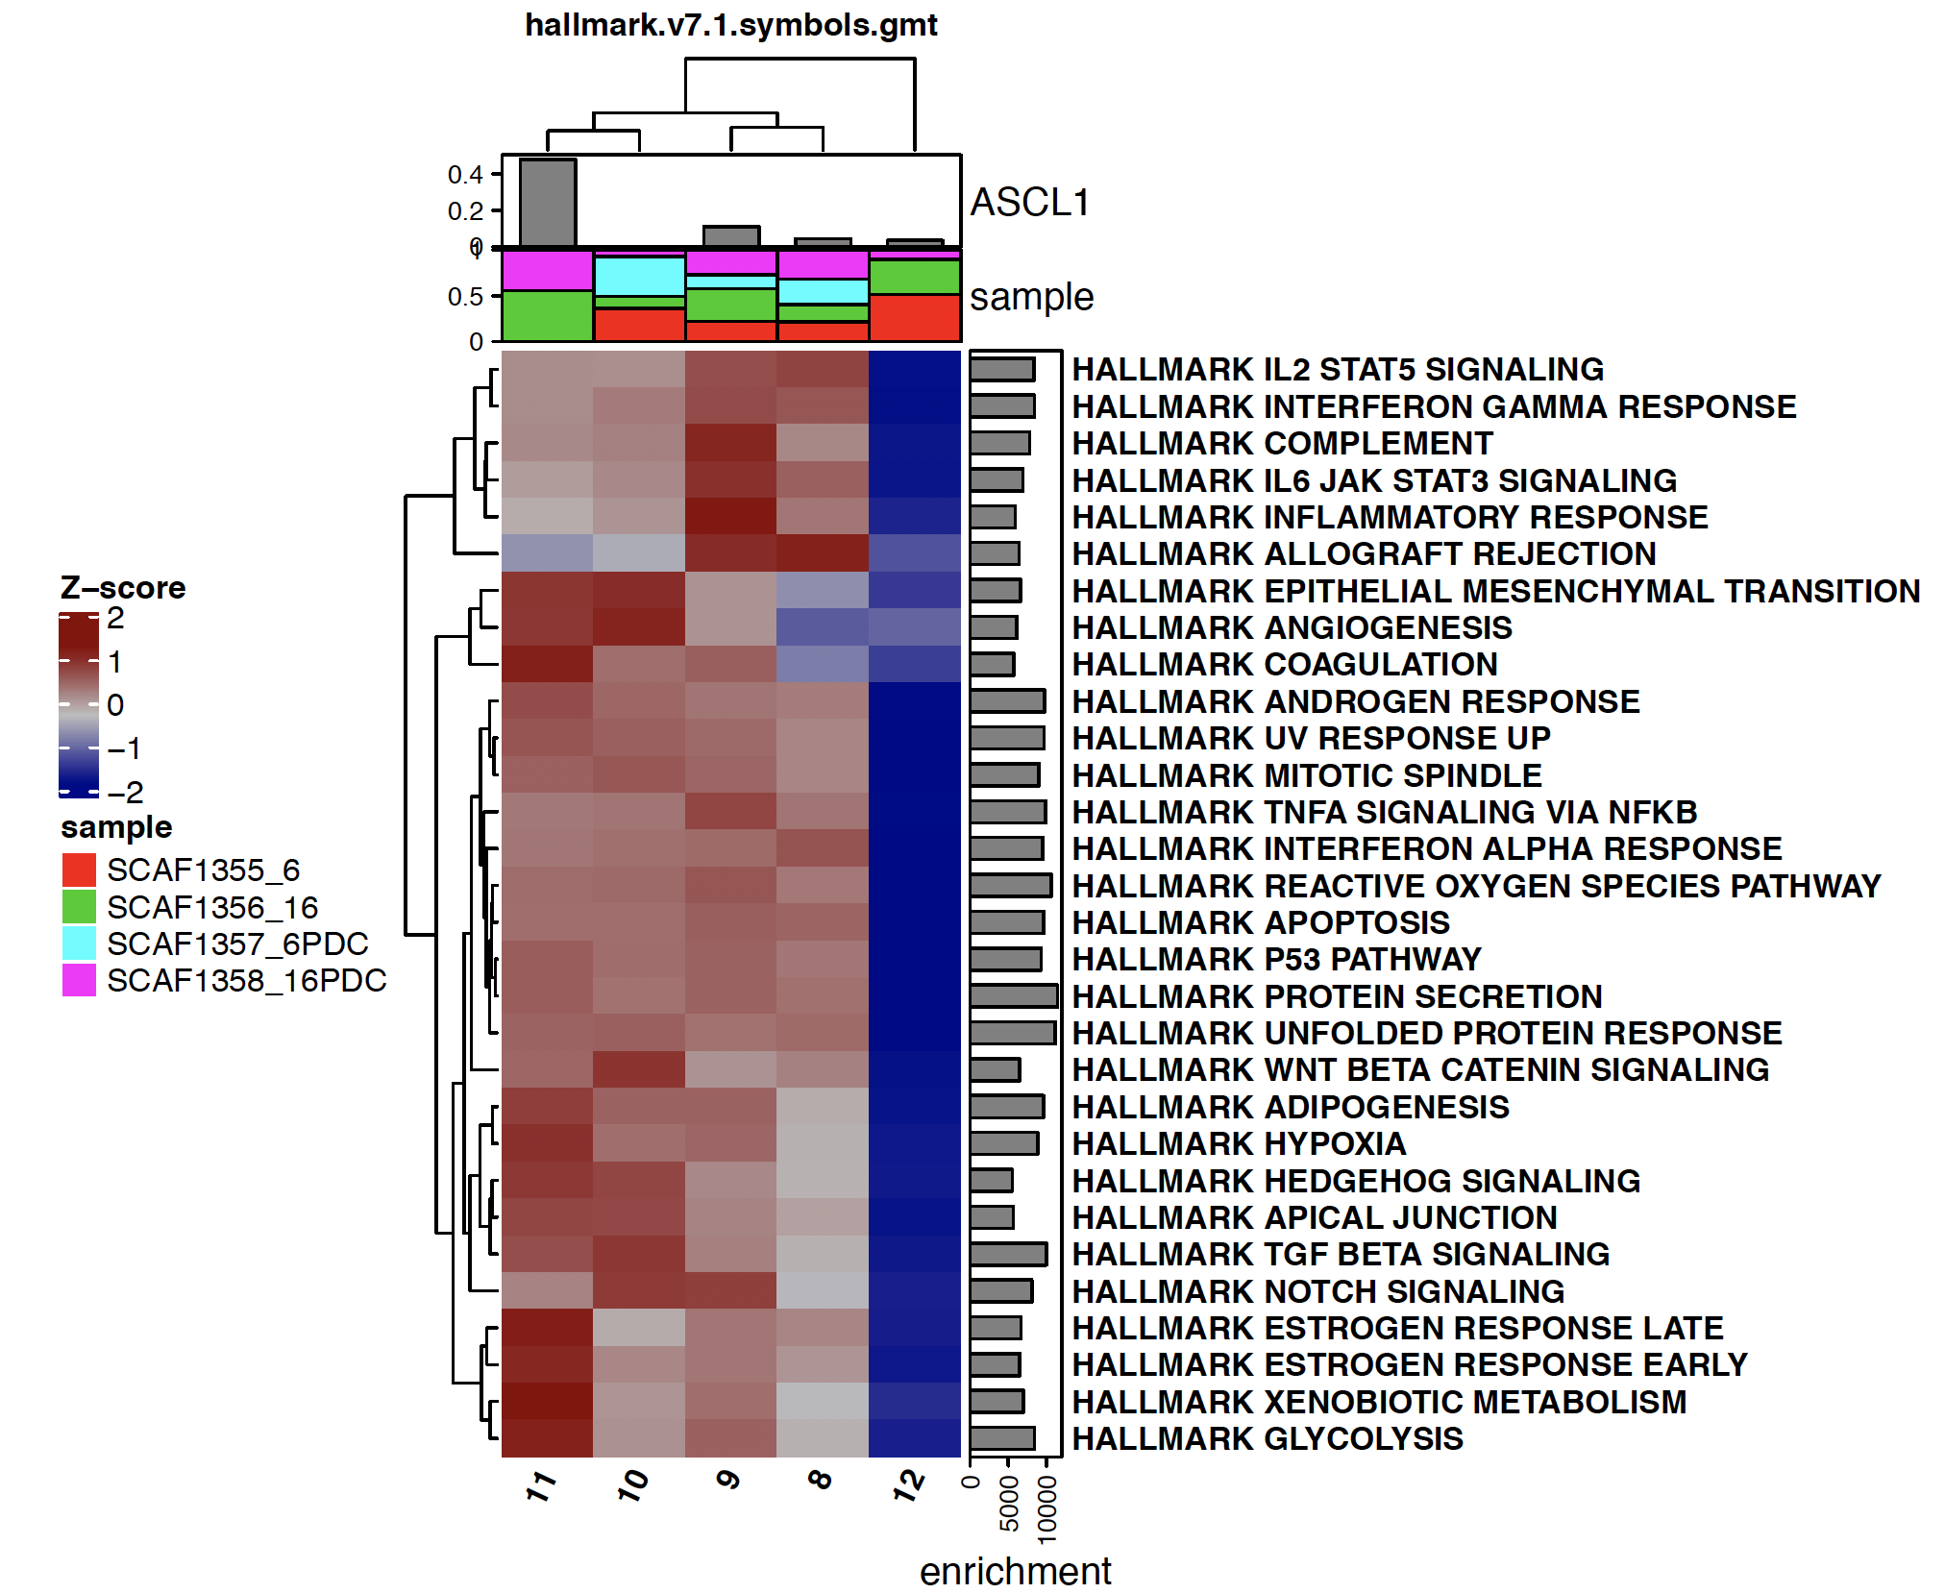
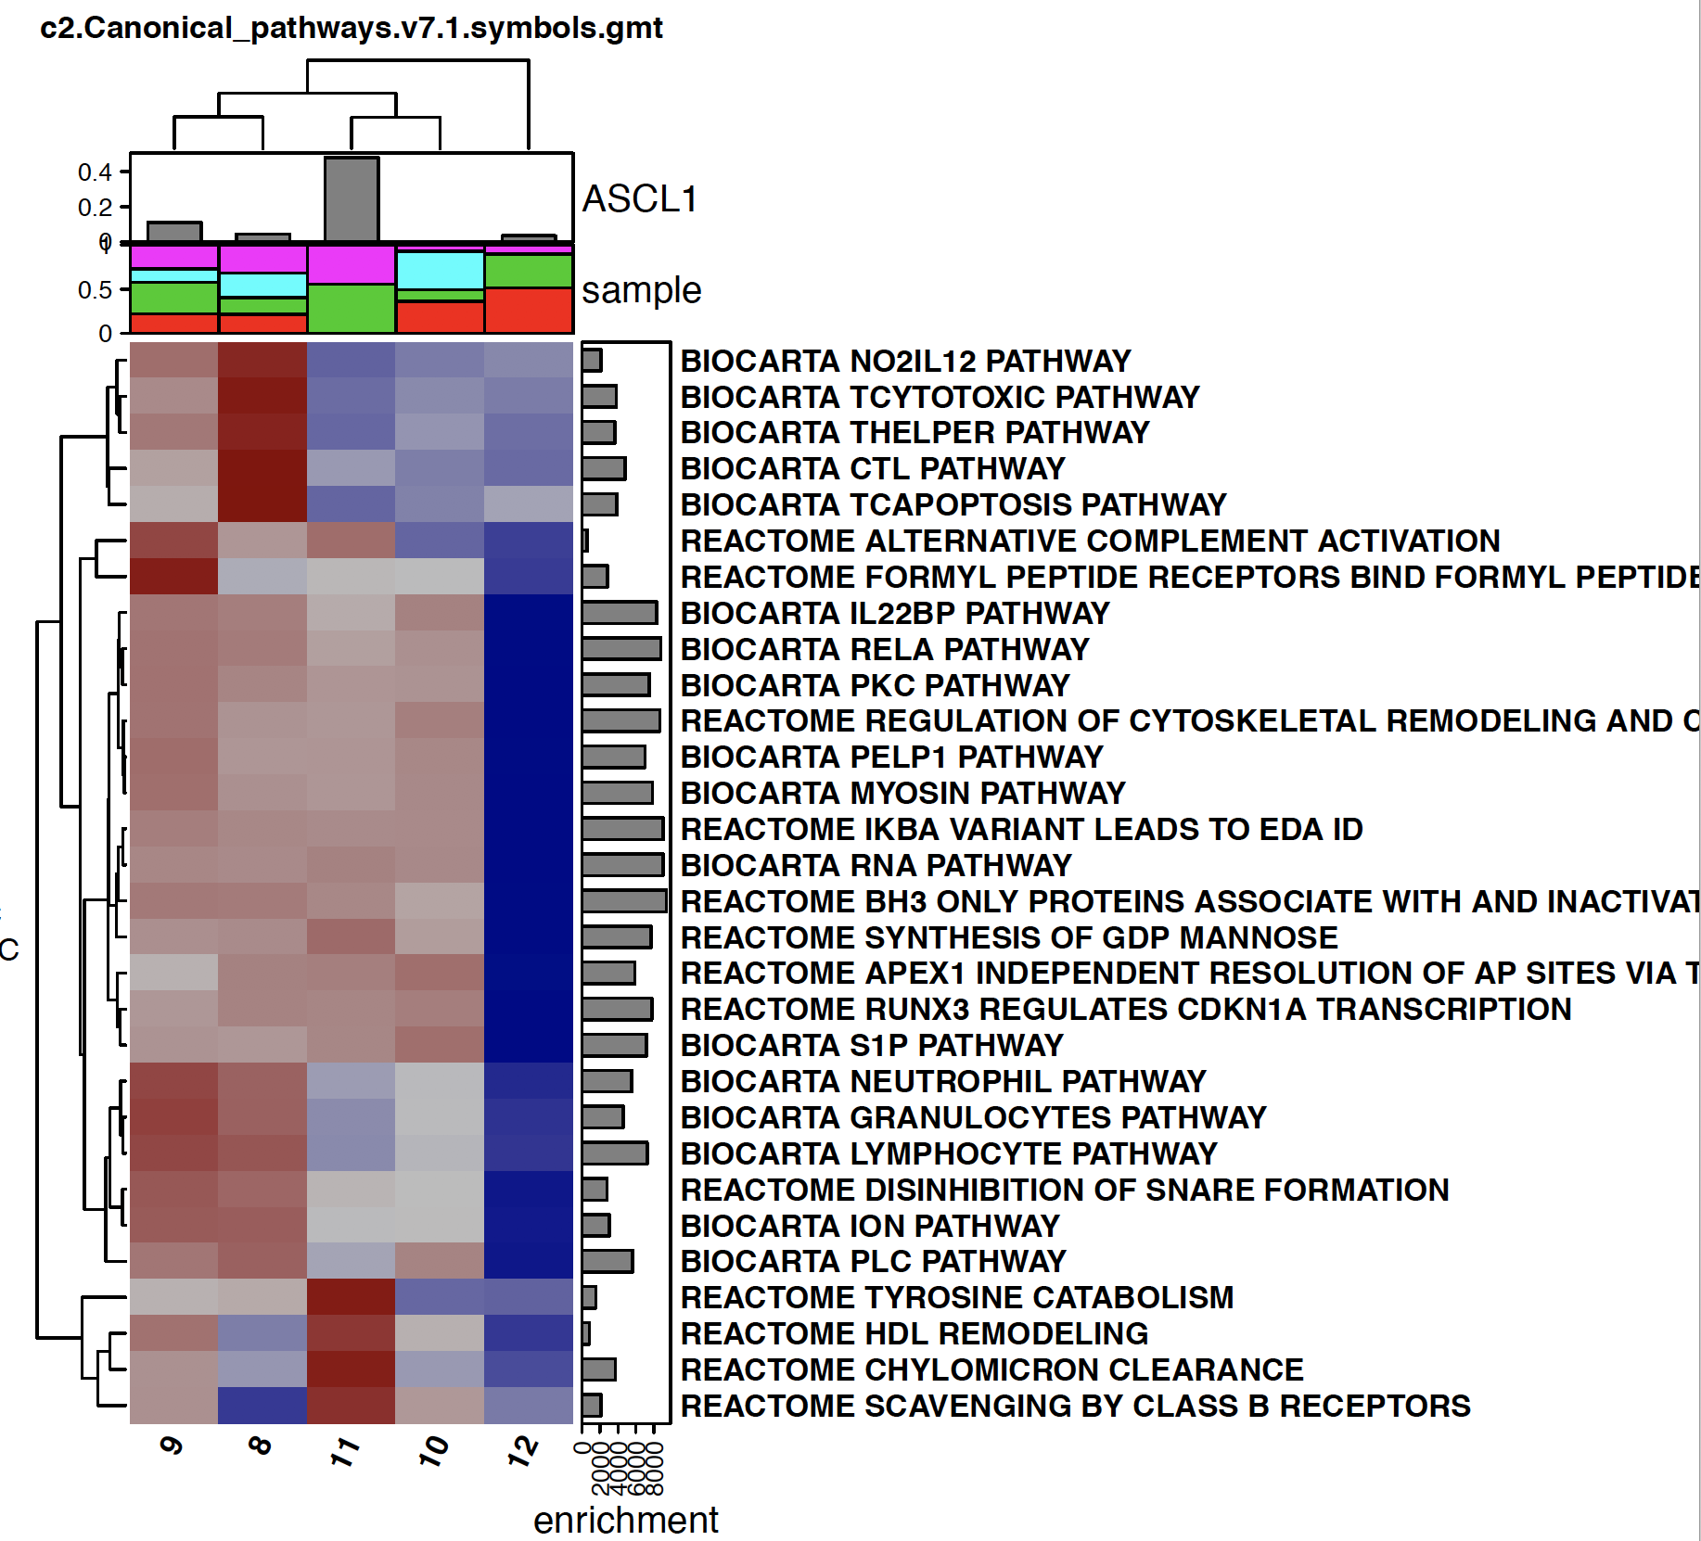
Immune clusters hallmark and canonical pathway GSCA enrichment

